Slide 1
Inference Systems

Slide 2
Outline
Background
Core Features – KV Caching, Batching, Paged Attention
Decoding
Small Inference Demo

Slide 3
What is inference?
Notes:
What is inference? All of you must have used some LLM, such as ChatGPT or Gemini etc. This is inferencing, the process of running an LLM, giving it a prompt and getting the response from it.

Slide 4
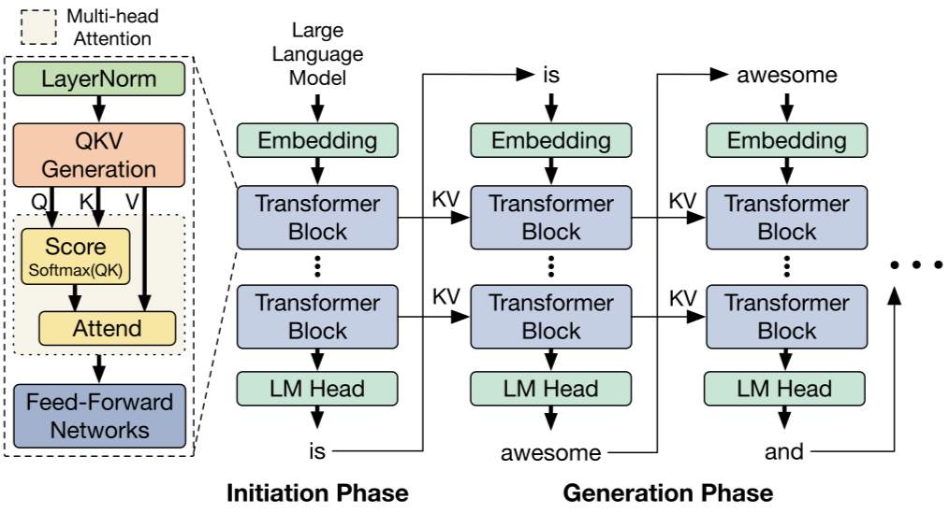
What is inference?
Text generation
https://magazine.sebastianraschka.com/p/building-a-gpt-style-llm-classifier
Notes:
The most popular kind is text generation, which is when you give a prompt and get the output. In this example we have ”Large Language Model” has the prompt and get the output as “is awesome and …”
But there are other kinds as well, this is handled by what we call the LM Head (Language Model Head). One example is Classification, where the LLMs output a binary or multi-class output . You would use this for tasks such as spam classification.
Another kind is translation, where LLMs digest the entire the entire input and spit out the entire output in one go instead of one token at a time.

Slide 5
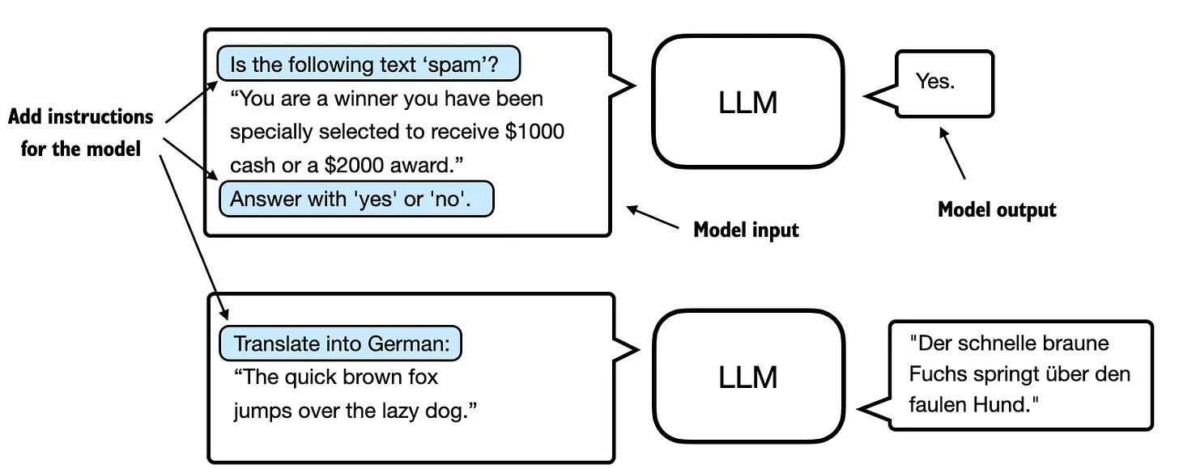
What is inference?
Text generation
Classification
Translation
https://magazine.sebastianraschka.com/p/building-a-gpt-style-llm-classifier
Notes:
But there are other kinds as well, One example is Classification, where the LLMs output a binary or multi-class output . You would use this for tasks such as spam classification.
Another kind is translation, where LLMs digest the entire the entire input and spit out the entire output in one go instead of one token at a time.
The way this is handled is by what we call the LM Head (Language Model Head). Its task is to convert the math output of the model into task specific output format

Slide 6
Transformers Architecture

Slide 7
time
Layer / Block
x₁
x₂
x₃
c₁
c₂
c₃
Layer 2
MLP
MLP
MLP
attn
attn
attn
v₁
v₂
v₃
k₁
k₂
k₃
q₁
q₂
q₃
b₁
b₂
b₃
MLP
MLP
MLP
Layer 1
attn
attn
attn
v₁
v₂
v₃
k₁
k₂
k₃
q₁
q₂
q₃
a₁
Once
a₂
upon
a₃
a
Notes:
First, let’s have a reminder of the LLM architecture.
- You have N layers (this varies from model to model). For ex. A small GPT model has around 12 layers, larger Llama models has 32 or 64 layers.
Take a token “Once” (this representation as text is not correct, it is technically an embedding representation).
We have a special focus on attention. We have the qkv generation which is used for self attention. The output is used for MLP calculation. These are just the main ones, there are other things that happen like layer normalization, etc.
This happens for all the tokens. A token goes through the math and we have intermediate output of the second layer, which is represented as b’s and so on, until we get the output of the last layer, represented as x.
A bit of focus on self-attention, where the words like “Once” and “upon” and influence the third token “a”.
Causal self-attention is the single directional influence, where only the past tokens can influence the future tokens without the future tokens influencing the past.

Slide 8
Background/Terminology

Slide 9
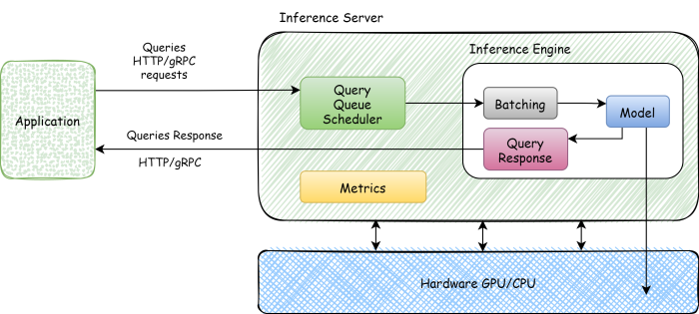
1. Inference engines
Wrap systems concepts around the process of inference
Batching
Streaming
Fault management
Parallelism (multi-GPUs)
Optimizations:
Memory storage optimizations
Offloading
Speculative decoding
Most popular open-source is vllm
https://ranjankumar.in/large-language-models-llms-inference-and-serving/
Notes:
Must have used ChatGPT – you know the underlying model they use varies from GPT3 to 4 to 5, and all the variants they had in between. GPT is the model, so what is ChatGPT – the entire interface around serving the model.

Slide 10
2. forward vs generate
Forward: single forward pass through LLM
Generate: Multiple tokens, until EOS or max tokens reached
source : https://arxiv.org/pdf/2408.05499
Notes:
Forward is used in training as well
Generate also includes the decoding strategy, which I will dive deeper into towards the end of the talk

Slide 11
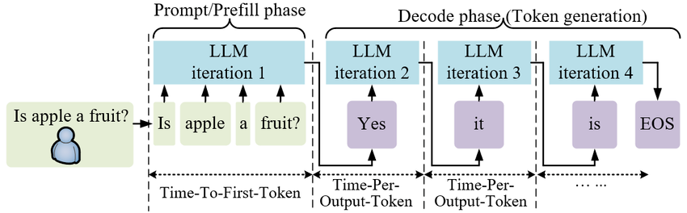
3. Prefill
Prefill: input/prompt phase. Generation of the first output token (ingestion of the entire input in parallel)

Slide 12
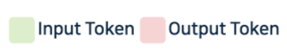
3. Prefill vs decode
Prefill: input/prompt phase. Generation of the first output token (ingestion of the entire input in parallel)
Decode: output/generation phase. Decoding of subsequent output tokens (sequential)
Notes:
Auto-regressive nature of LLMs means that decode can only happen for one token at a time

Slide 13
3. Prefill vs decode
Parallel process
Forward of all tokens happens in one iteration
Sequential Process
Forward of one token in one iteration

Slide 14
4. Metrics
Throughput: Number of Tokens processed per second
Latency:
Time to First Token (prefill time)
Time between Tokens (decode time)
Time Between Tokens
(inter-token latency)
Time To First Token

Slide 15
Core features

Slide 16
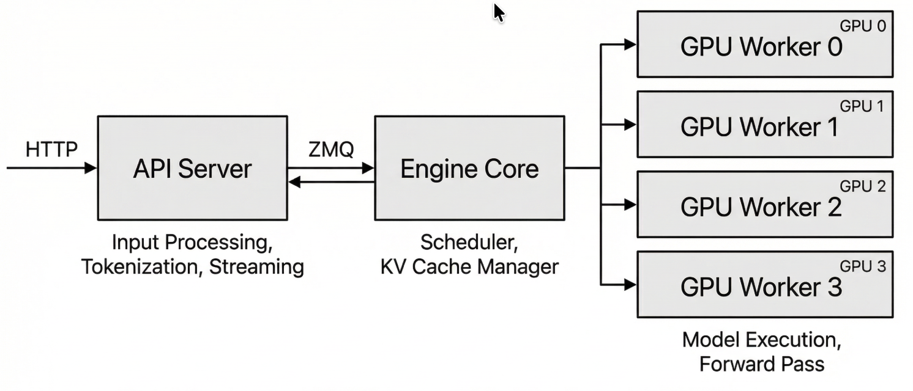
Core features of inference engines
Inference engines such as vllm etc. have many features/optimizations
We will look at 3 such techniques:
KV Caching
Prefix Caching
https://docs.vllm.ai/en/latest/design/arch_overview/#process-count-summary

Slide 17
1. KV Caching

Slide 18
Why KV Caching?
1. What are K and V used for?
Self-attention calculation requires Q of current token and K&V of other tokens
Causal self-attention requires K&V of all past tokens

Slide 19
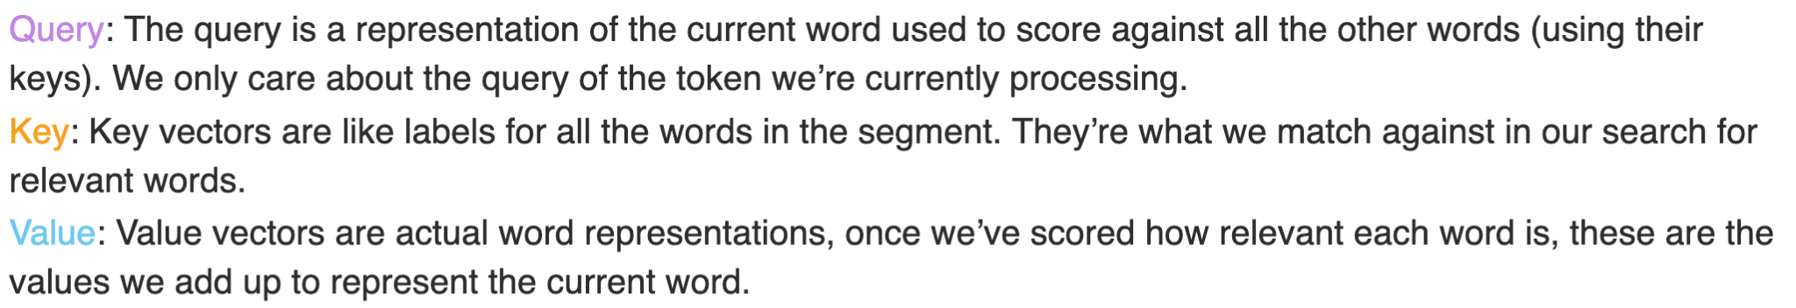
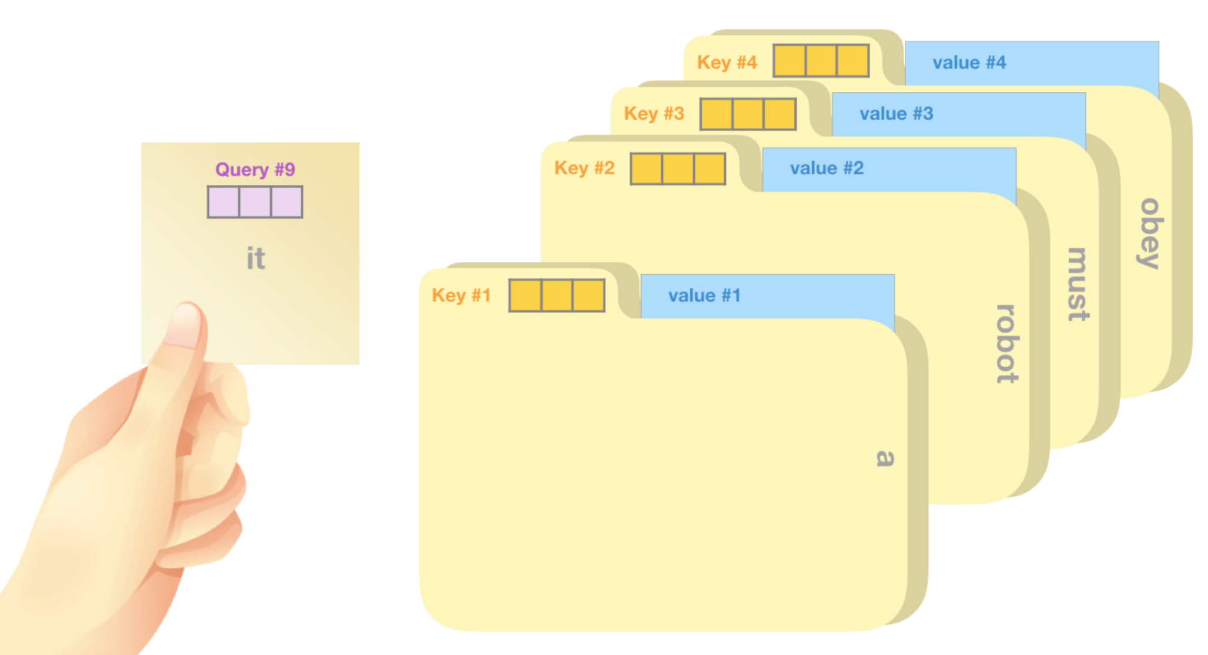
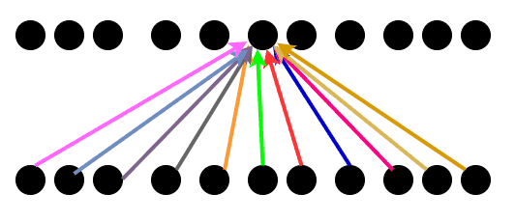
Goal of attention: infusion of context
Notes:
Reminder of attention mechanism. A normal token/word needs to be infused with the context surrounding it. With the attention mechanism, a word like bank which is ambiguous is infused with its surrounding words such that the final representation is a different object in the embedding space for the river bank versus the money bank.
enhances the information content of an input embedding by including information about the input’s context
How does attention work? Every word/token has 3 representations that are used in the calculation of attention.

Slide 20
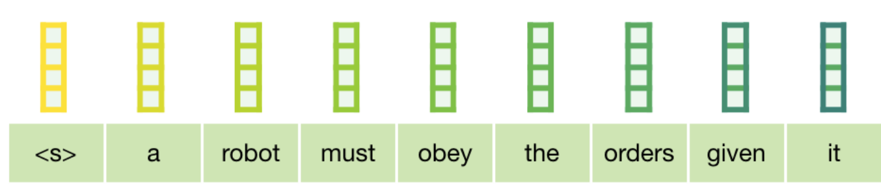
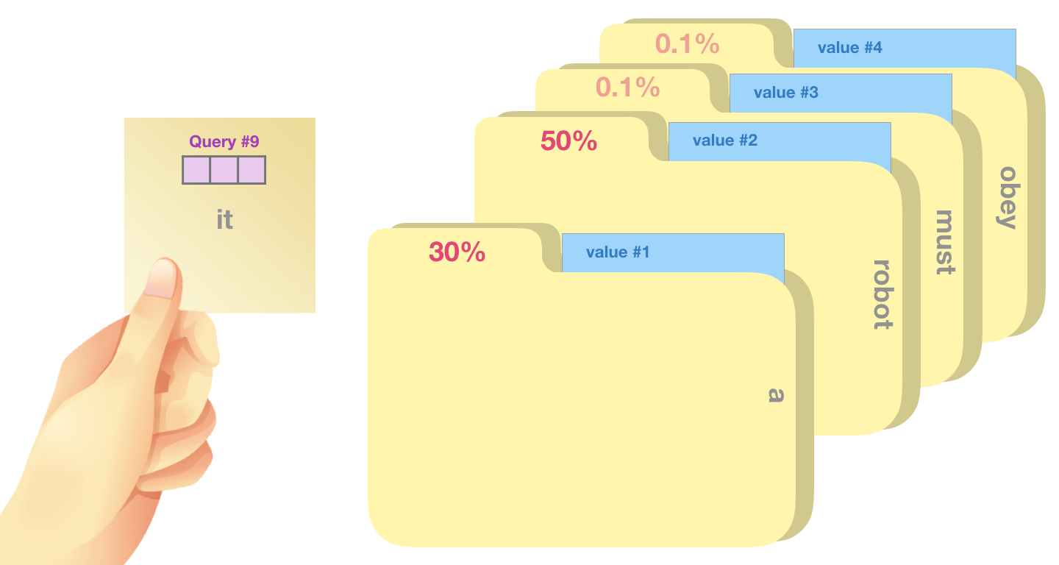
Q.K is a score:
how relevant is a past token (through its K representation) to the current token (through its query representation)

Slide 21
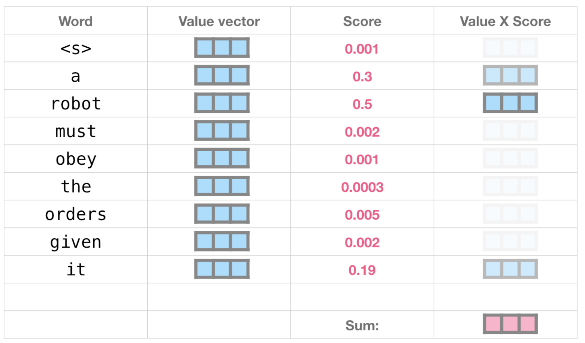
Finally, each past token (through its Value Representation) is multiplied with the score and summed up to obtain a new representation of the current token

Slide 22
Why KV Caching?
1. What are K and V used for?
Self-attention calculation requires Q of current token and K&V of other tokens
Causal self-attention requires K&V of all past tokens
2. Why cache K and V?
Problem: It is recalculated again and again for every token
Idea: Generate and cache once, reuse for subsequent tokens

Slide 23


x₂ = “a”
c₂
Layer 2
v₁
v₂
k₁
k₂
q₁ = Q.a₁
b₁is output after layer 1
For every token, only its q matters
Causal attention: For every token, only its and past tokens’ k,v matter
q₁
q₂
b₁
b₂
Layer 1
v₁
v₂
k₁
k₂
q₁
q₂
k₁= K.a₁
a₁
Once
a₂
upon
Notes:
Take example where we have 2 tokens – once and upon. For calculating the attn of a2 at layer 1, we use the k1 and v1 of a1. Similarly, for attn of b2 at layer 2, we need the k1 and v1 of b2.

Slide 24

Why is KV recomputed?
v₁
v₂
v₃
k₁
k₂
k₃
q₁
q₂
q₃
b₁
b₂
b₃
1. We need the K and V of all tokens in the past, at every layer
2. This requires calculation of b1, b2 etc. for all past tokens
v₁
k₁
v₂
v₃
k₂
k₃
q₁
q₂
q₃
a₁
Once
a₂
upon
a₃
a
Notes:
Assume prompt is “Once upon”
Roughly going to represent the attention multiplication as Q. sum of K, V since a single token’s query is multiplied with pairs of keys and values
Start with prefill: a1 mulitipleied with Q, K, V of layer 1 to produce output b1 after MLP, layernorm etc.
Then goes through layer 2 to get say c1
What happens to a2? Same, except it also needs k1 and v1 (because of causal self-attention) apart from its own k and v. We get b2, then again use k1 and v1 at layer 2 to compute c2.
Decode: Multiple by Q, K, V. You again need to do self-attention. Which all ks and vs does it need?

Slide 25
x₂ = “a”
c₂
Layer 2
v₁
v₂
k₁
k₂
q₁
q₂
b₁
b₂
Layer 1
v₁
v₂
k₁
k₂
q₁
q₂
k₁= K.a₁
a₁
Once
a₂
upon
Notes:
Take example where we have 2 tokens – once and upon. For calculating the attn of a2 at layer 1, we use the k1 and v1 of a1. Similarly, for attn of b2 at layer 2, we need the k1 and v1 of b2.

Slide 26
x₂ = “a”
c₂
Layer 2
v₁
v₂
k₁
k₂
q₁
q₂
b₁
b₂
Layer 1
v₁
v₂
k₁
k₂
q₁
q₂
k₁= K.a₁
a₁
Once
a₂
upon
Notes:
Take example where we have 2 tokens – once and upon. For calculating the attn of a2 at layer 1, we use the k1 and v1 of a1. Similarly, for attn of b2 at layer 2, we need the k1 and v1 of b2.

Slide 27
c₃
v₁
v₂
v₃
k₁
k₂
k₃
q₁
q₂
q₃
b₁
b₂
b₃
v₁
v₂
v₃
k₁
k₂
k₃
q₁
q₂
q₃
k₁= K.a₁
a₁
Once
a₂
upon
a₃
a

Slide 28
c₃
v₁
v₂
v₃
k₁
k₂
k₃
q₁
q₂
q₃
b₁
b₂
b₃
We don’t pass entire input for every decode run, only the last token
v₁
v₂
v₃
k₁
k₂
k₃
q₁
q₂
q₃
a₁
Once
a₂
upon
a₃
a

Slide 29
What is the size of the KV cache?
c₃
v₁
v₂
v₃
k₁
k₂
k₃
q₁
q₂
q₃
How many KVs are we storing?
Num layers x
Num tokens x
2
Size of K/V?:
Embedding size
b₁
b₂
b₃
v₁
v₂
v₃
k₁
k₂
k₃
q₁
q₂
q₃
a₁
Once
a₂
upon
a₃
a
Notes:
We need one for every red box in this figure

Slide 30
2. Prefix Caching

Slide 31
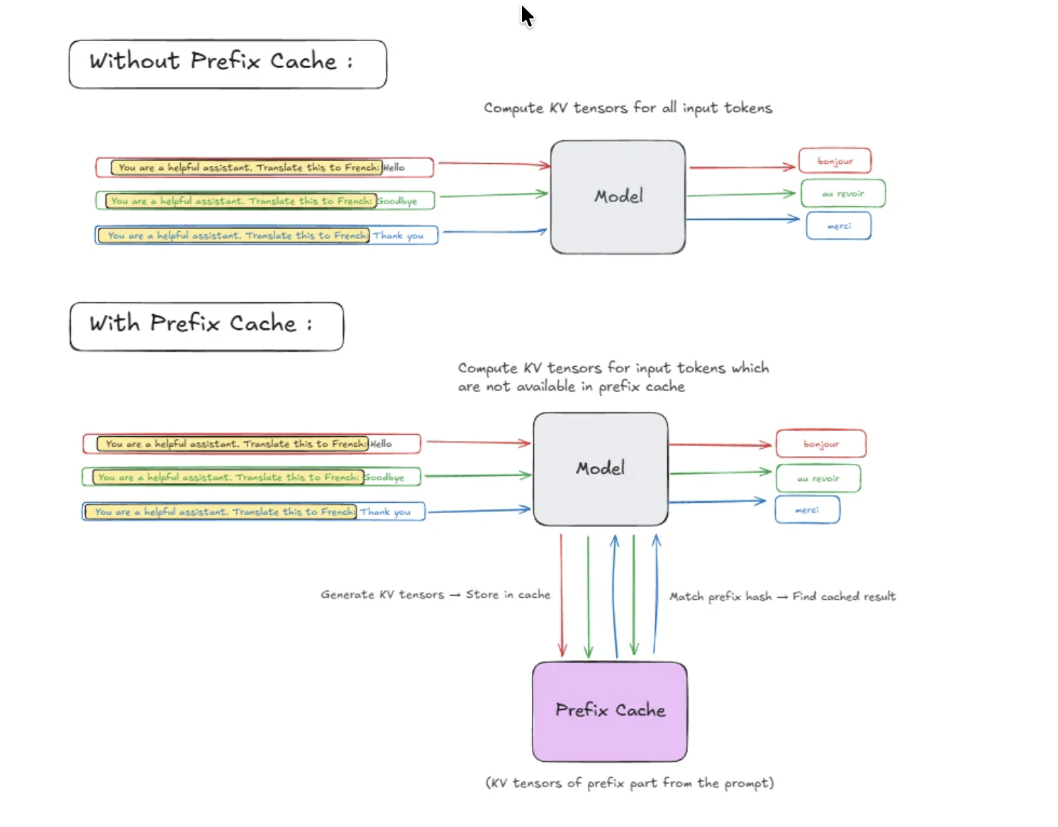
https://jarvislabs.ai/blog/vllm-optimization-techniques

Slide 32
Decoding strategies

Slide 33
time
x₃
c₁
c₂
c₃
Layer 2
MLP
MLP
MLP
attn
attn
attn
v₁
v₂
v₃
k₁
k₂
k₃
q₁
q₂
q₃
Not a token!
What is the output of forward?
b₂
b₃
b₁
MLP
MLP
MLP
Layer 1
attn
attn
attn
v₁
v₂
v₃
k₁
k₂
k₃
q₁
q₂
q₃
a₁
Once
a₂
upon
a₃
a
Notes:
We did some simplification – it is not a token

Slide 34
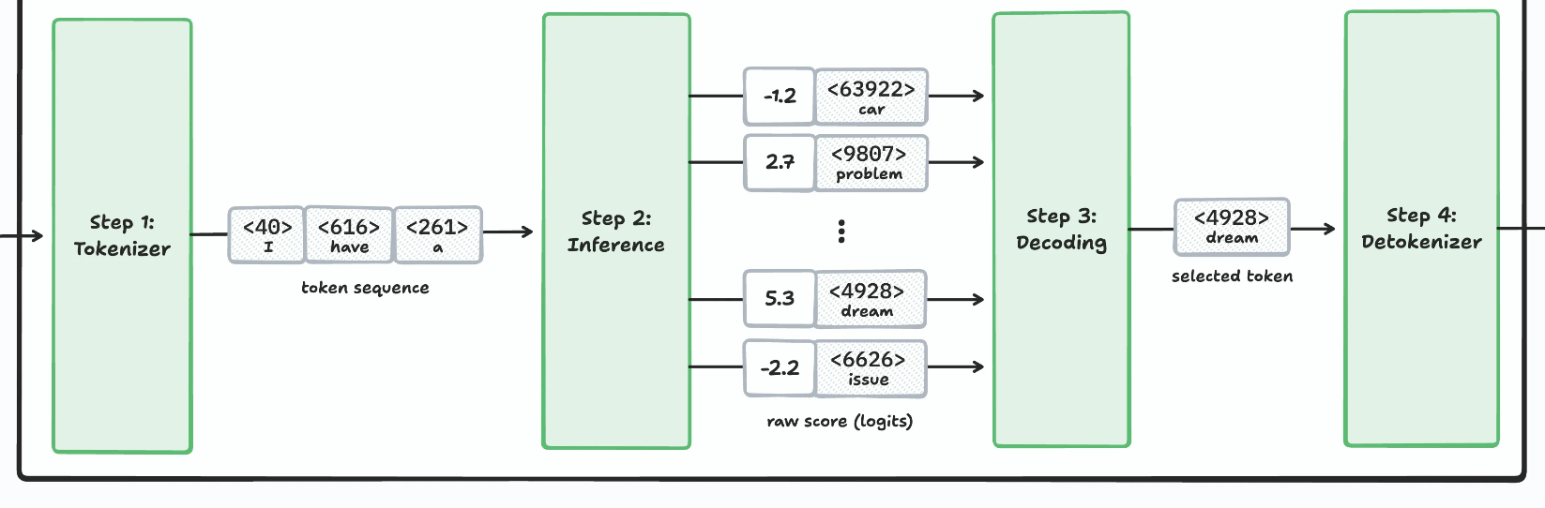
What is the output of forward?
Input
Output
https://pm.dartus.fr/posts/2025/how-llm-generate-text/

Slide 35
What is the output of forward?
Logits: A degree of similarity to each token in the vocabulary
Input
Output
https://pm.dartus.fr/posts/2025/how-llm-generate-text/

Slide 36
Decoding
Input
Output
https://pm.dartus.fr/posts/2025/how-llm-generate-text/
Notes:
To get the actual textual output, we need to perform decoding to select a single output token

Slide 37
Decoding Strategies
Which token to predict as response?
logits = model(inputs, positions)
print(logits.shape)
[x, 50257]
Vocab size
Batch size
How to convert these logits to a token?
https://huggingface.co/blog/mlabonne/decoding-strategies

Slide 38
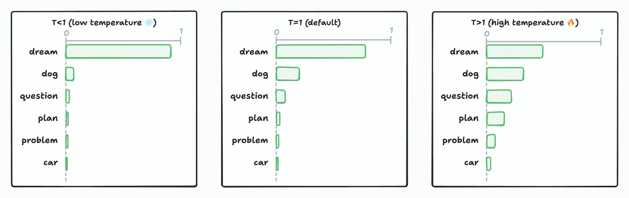
Softmax and temperature
Logit (similarity score) -> Probability score (that adds up to 1)
This is done via a softmax normalization function which has a “temperature” parameter which scales the logits value.
Low temperature: Gives more weight to already heavy ones
High temperature: Gives more weight to less heavy ones
Makes values more extreme
Makes values more centered
More creative and diverse
More deterministic

Slide 39
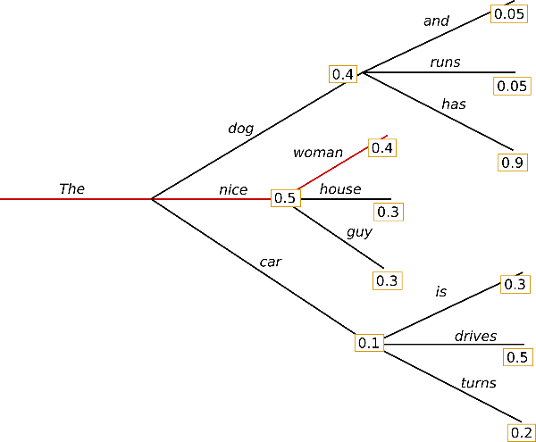
Greedy search
Choose word with highest probability at every step
Problems:
It starts repeating itself after some time
Misses high prob. words hidden behind low prob. words
next_token = torch.argmax(logits, dim=-1, keepdim=True)
https://huggingface.co/blog/how-to-generate

Slide 40
Greedy Search
> I enjoy walking with my cute dog
I enjoy walking with my cute dog, but I'm not sure if I'll ever be able to walk with my dog. I'm not sure if I'll ever be able to walk with my dog. I'm not sure

Slide 41
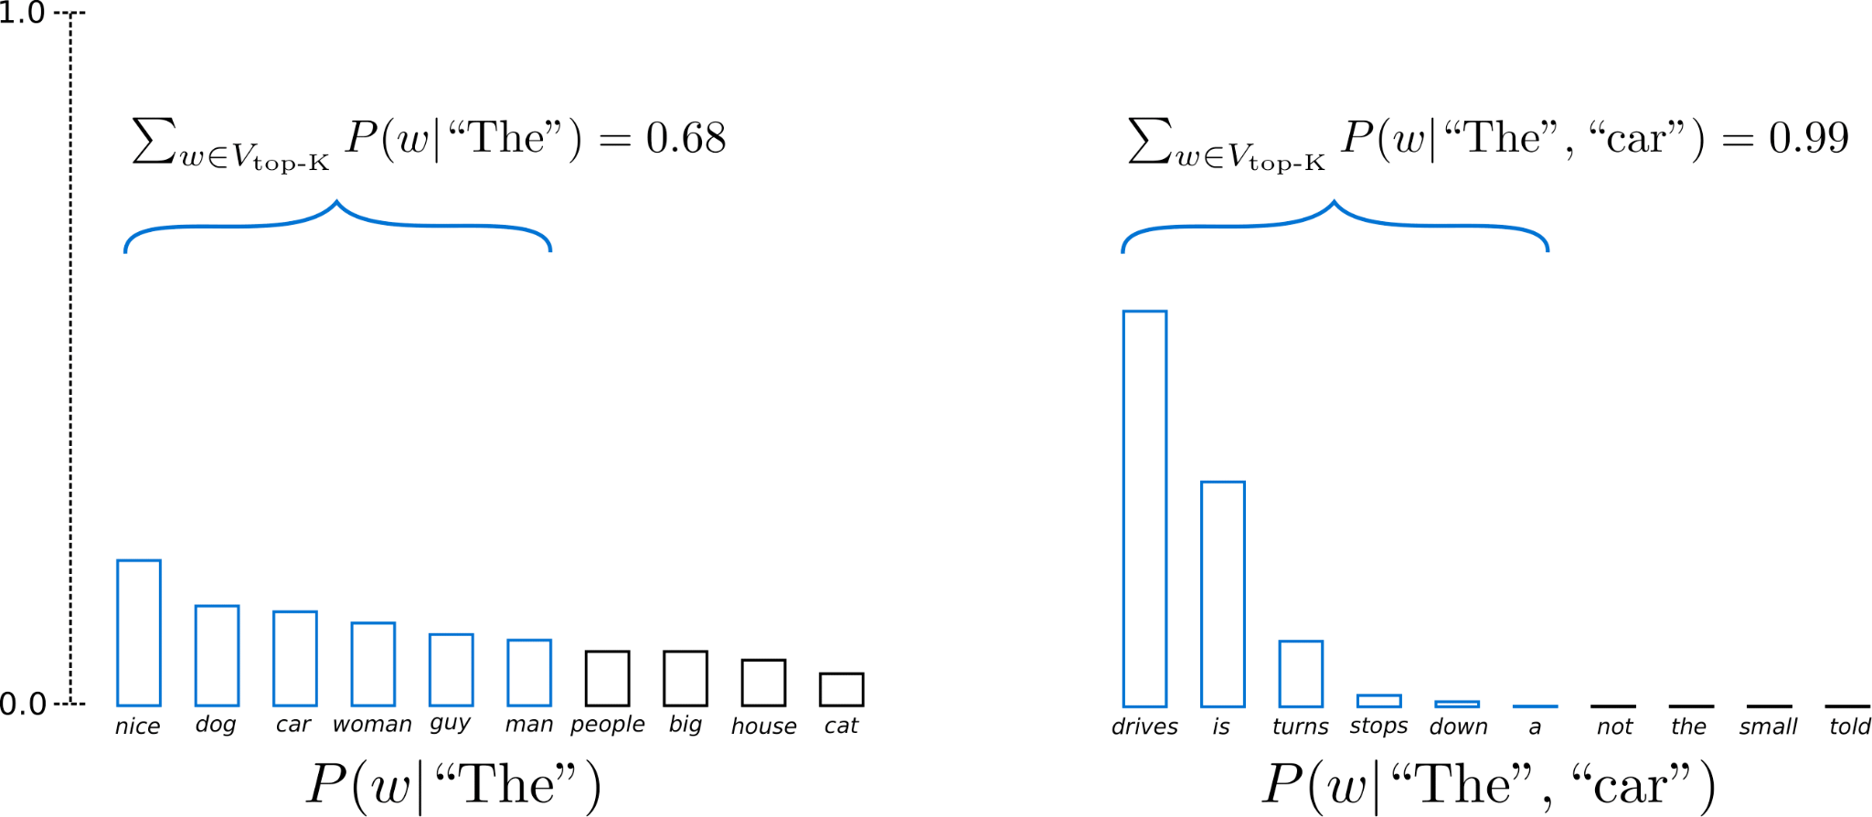
Top-K Sampling
Randomly pick one of the output tokens
But this could bias towards the long tail of irrelevant options
Select only top-K of those and normalize the probability
How to decide K?

Slide 42
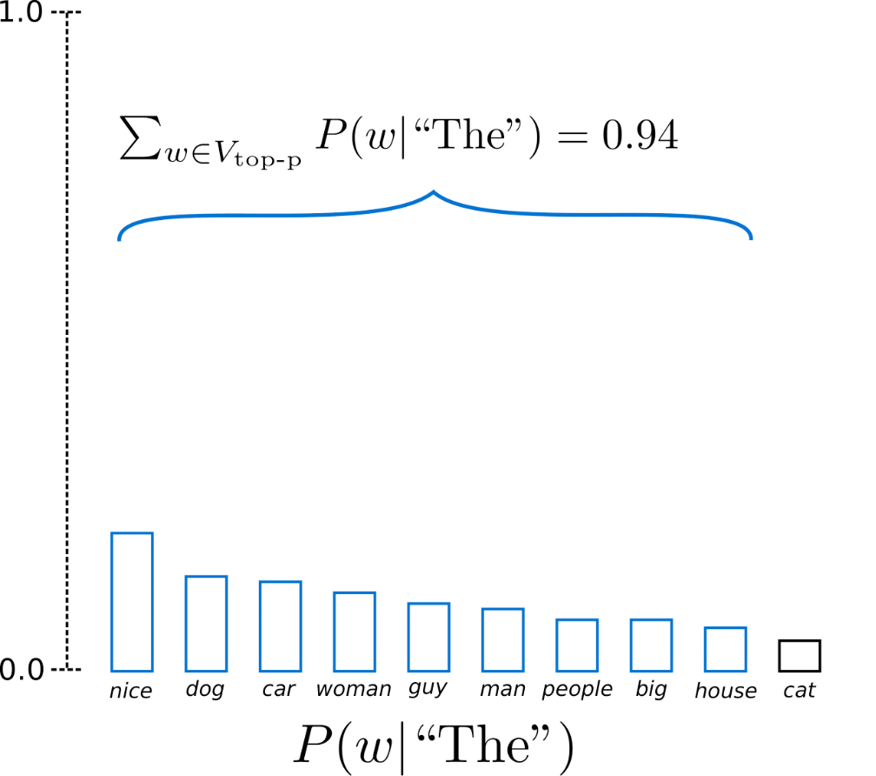
Top-p sampling
First decide threshold probability p (0.94)
K is decided by the number of options that add up to p

